Slide 1
Time Horizons

Slide 2
Quick Review

Slide 3
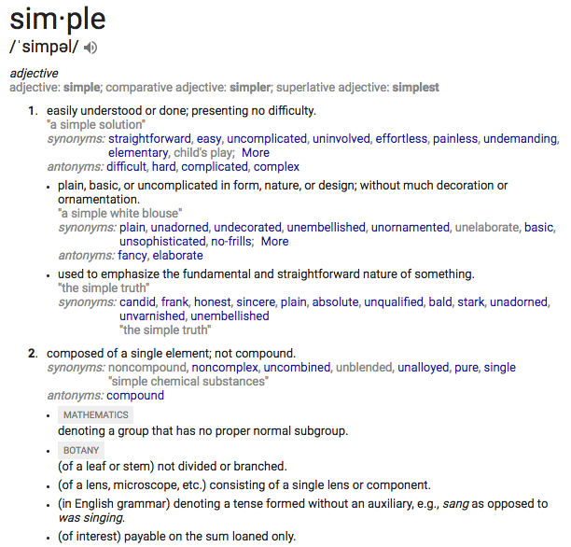

Slide 4
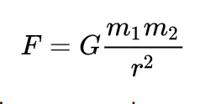
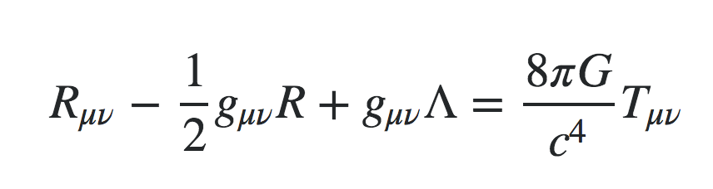
Notes:
There’s a progression to reaching simplicity.
First we make the observation and create a crud abstraction.
Then we develop generalized principle.
Then we create an abstraction with is as close to the primative data abstrations with minimal independent variable.
From there we can make leaps that go beyond the original domain.

Slide 5
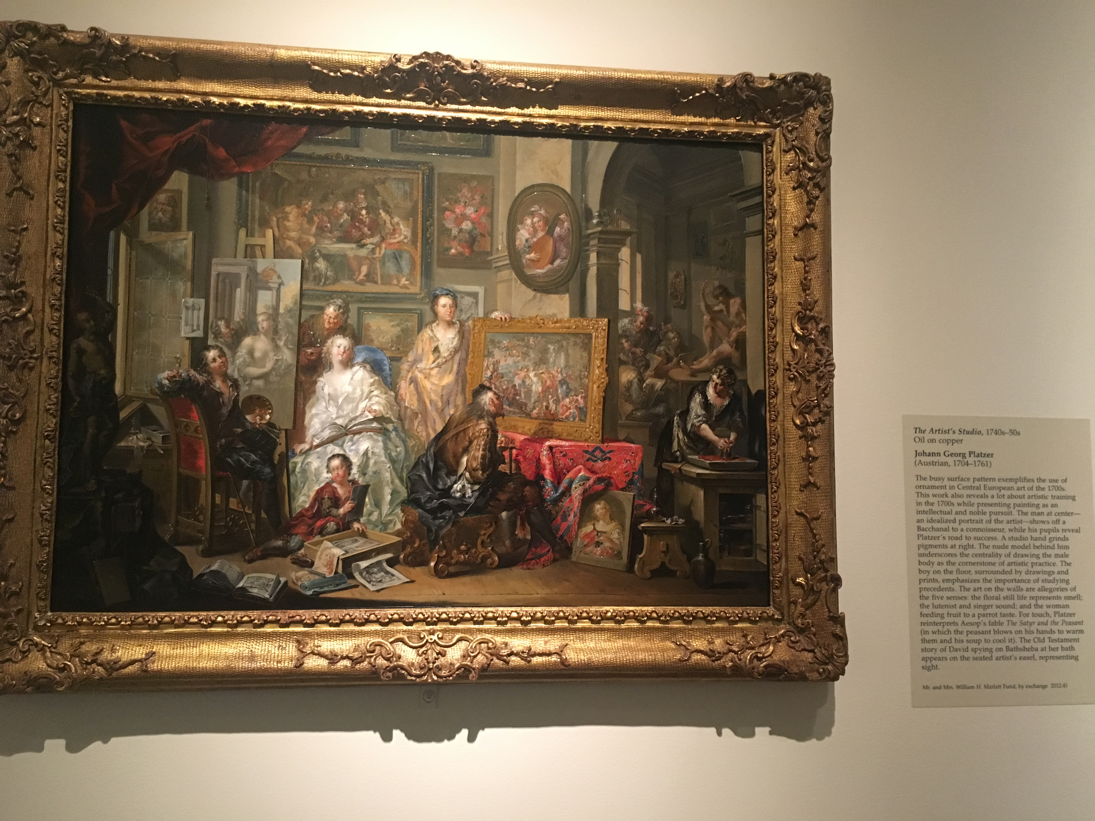
(255,255,255) | (255,255,255) | (255,255,255) | (255,255,255) | (255,255,255) | (255,255,255) | (255,255,255)
(255,255,255) | (255,255,255) | (255,255,255) | (255,255,255) | (255,255,255) | (255,255,255) | (255,255,255)
(255,255,255) | (255,255,255) | (255,255,255) | (255,255,255) | (255,255,255) | (255,255,255) | (255,255,255)
(255,255,255) | (255,255,255) | (255,255,255) | (255,255,255) | (255,255,255) | (255,255,255) | (255,255,255)
(255,255,255) | (255,255,255) | (255,255,255) | (255,255,255) | (255,255,255) | (255,255,255) | (255,255,255)
(255,255,255) | (255,255,255) | (255,255,255) | (255,255,255) | (255,255,255) | (255,255,255) | (255,255,255)
(255,255,255) | (255,255,255) | (255,255,255) | (255,255,255) | (255,255,255) | (255,255,255) | (255,255,255)
Johann Georg Platzer (Austrian, 1704-1761)
The Artist's Studio, (Austria 1740s-1750s)

Slide 6
(92, 76, 50) | (130, 102, 61) | (128, 95, 73) | (129, 104, 70) | (169, 96, 70) | (100, 72, 54) | (65, 57, 41)
(112, 99, 71) | (173, 162, 138) | (144, 127, 93) | (152, 144, 123) | (182, 172, 143) | (87, 72, 46) | (160, 128, 88)
(124, 103, 70) | (175, 151, 115) | (241, 208, 185) | (123, 101, 64) | (173, 117, 56) | (151, 130, 101) | (111, 83, 61)
(72, 34, 25) | (63, 47, 30) | (255, 240, 223) | (123, 101, 64) | (80, 64, 48) | (181, 127, 92) | (48, 37, 24)
(75, 42, 28) | (35, 34, 30) | (211, 159, 126) | (153, 112, 77) | (175, 126, 88) | (139, 52, 44) | (172, 58, 46)
(35, 29, 14) | (55, 41, 23) | (167, 69, 60) | (102, 62, 33) | (44, 42, 33) | (173, 90, 76) | (64, 40, 26)
(35, 29, 14) | (95, 72, 49) | (55, 58, 49) | (167, 136, 109) | (152, 104, 55) | (99, 65, 38) | (57, 35, 16)
Johann Georg Platzer (Austrian, 1704-1761)
The Artist's Studio, (Austria 1740s-1750s)

Slide 7
(255,255,255) | (255,255,255) | (255,255,255) | (255,255,255) | (255,255,255) | (255,255,255) | (255,255,255)
(255,255,255) | (255,255,255) | (255,255,255) | (255,255,255) | (255,255,255) | (255,255,255) | (255,255,255)
(255,255,255) | (255,255,255) | (255,255,255) | (255,255,255) | (255,255,255) | (255,255,255) | (255,255,255)
(255,255,255) | (255,255,255) | (255,255,255) | (255,255,255) | (255,255,255) | (255,255,255) | (255,255,255)
(255,255,255) | (255,255,255) | (255,255,255) | (255,255,255) | (255,255,255) | (255,255,255) | (255,255,255)
(255,255,255) | (255,255,255) | (255,255,255) | (255,255,255) | (255,255,255) | (255,255,255) | (255,255,255)
(255,255,255) | (255,255,255) | (255,255,255) | (255,255,255) | (255,255,255) | (255,255,255) | (255,255,255)
(255,255,255)
(255,255,255)
(255,255,255)
(255,255,255)
(255,255,255)
(255,255,255)
(255,255,255)
(255,255,255)
(255,255,255)
(255,255,255)
(255,255,255)
(255,255,255)
(255,255,255)
(255,255,255)
(255,255,255)
(255,255,255)
(255,255,255)
(255,255,255)
(255,255,255)
(255,255,255)
(255,255,255)
(255,255,255) | (255,255,255) | (255,255,255) | (255,255,255) | (255,255,255) | (255,255,255) | (255,255,255) | (255,255,255) | (255,255,255) | (255,255,255) | (255,255,255)

Slide 8
Health Care
Medication
CoverMyMeds
Payer
ePA
Central

Slide 9
Central
Correspondence → Generating Letters
LetterGenerator → Generate PDF
Review
User
Template
Template
Merge Field
Merge Field

Slide 10
Health Care
Medication
CoverMyMeds
Payer
ePA
Central
PA
PA

Slide 11
Time Horizons

Slide 12
Health Care
Medication
CoverMyMeds
Payer
ePA
Central
PA
PA

Slide 13
Health Care
Medication
CoverMyMeds
Payer
ePA
Central
PA
PA
CoverMyMeds
PA
Applicability

Slide 14
Health Care
Medication
CoverMyMeds
Payer
ePA
Central
PA
PA
Application Development
PA
Datetime, Integer, Text, String, …
Applicability

Slide 15
Health Care
Medication
CoverMyMeds
Payer
ePA
Central
PA
PA
Creation
Eligibility Check
Determination
…
PriorAuthorization
Datetime, Integer, Text, String, …
Applicability
Notes:
How do you make this not clunky

Slide 16


Slide 17
Creation

Slide 18
Eligibility

Slide 19
Determination

Slide 20
How handle PAs in different context?

Slide 22
Command Pattern
Create
Check Eligibility
Determinator
PA
PA
PA

Slide 23
Command Pattern with Delegation
Create
Check Eligibility
Determinator
Form
Request
Review
PA
PA
Supplemental Fields
Drug
Eligibility
Notes
PA

Slide 24
Demo

Slide 25
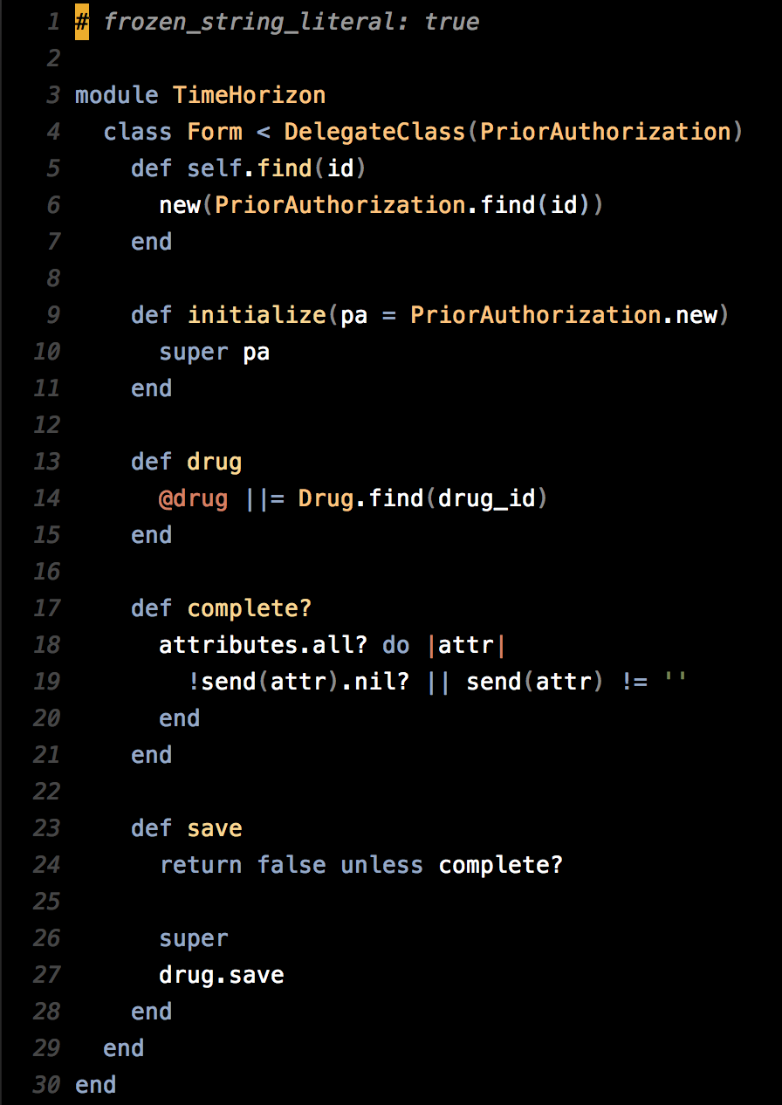
Form
PriorAuthorization
drug
Drug
complete?
complete?

Slide 26
Form
PriorAuthorization
Drug
drug
complete?
Creation
Eligibility Check
Determination
…
Form
Drug
PriorAuthorization
Datetime, Integer, Text, String, …
Applicability

Slide 27
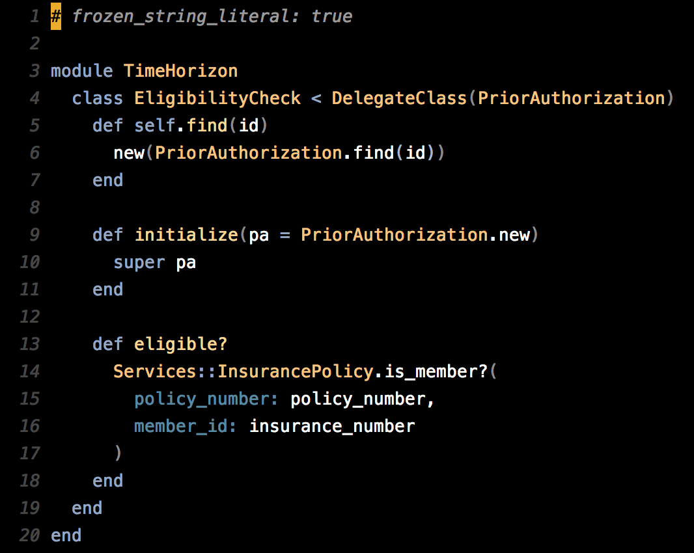
Eligibility
PriorAuthorization
InsurancePolicy
eligible?
eligible?

Slide 28
Eligibility
PriorAuthorization
InsurancePolicy
eligible?
Insurance Policy
Creation
Eligibility Check
Determination
…
Eligibility
Form
Drug
PriorAuthorization
Datetime, Integer, Text, String, …
Applicability

Slide 29
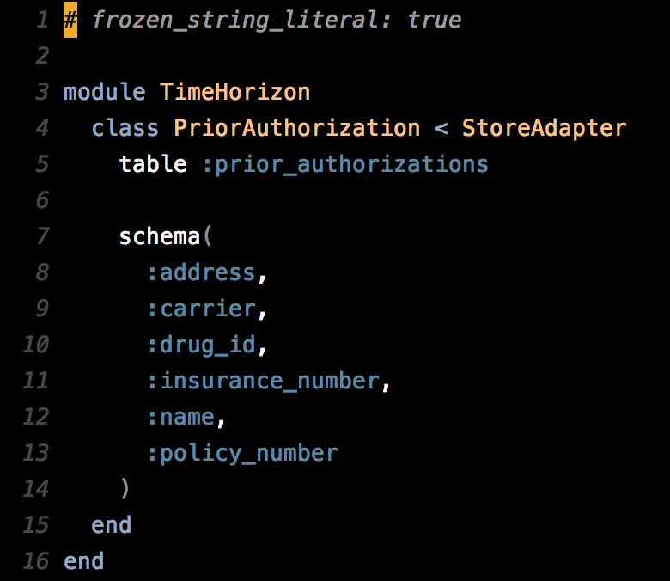
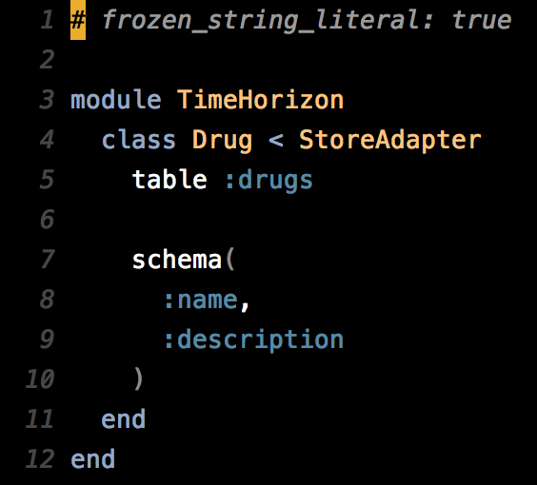

Slide 30
Think back to this analogy

Slide 31
H: 1
He: 2
C: ?
Al: 13
Datetime
String
Integer
Text

Slide 32
Person
Drug
Review
PriorAuthorization

Slide 33
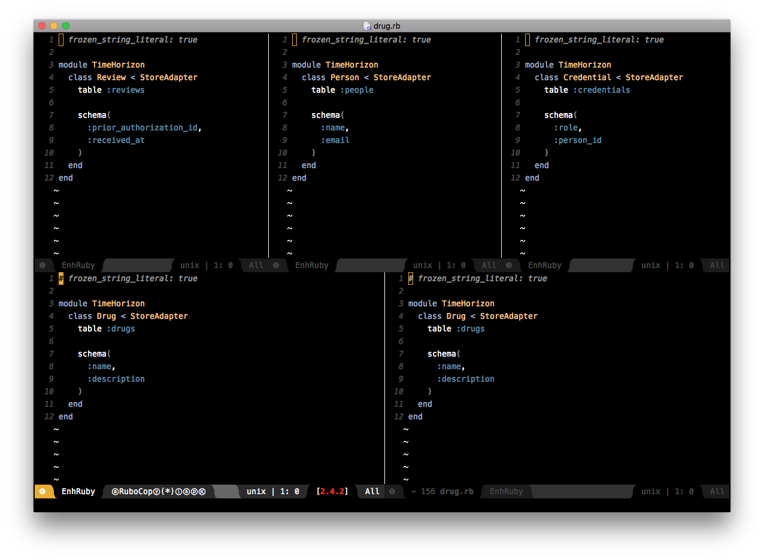

Slide 34
Determination
User
Form
Ninja

Slide 35
What’s a user?

Slide 38
Determination
Eligibility Check
Form
User
Ninja
Review
PriorAuthorization
Drug
Person
Credential

Slide 39
Determination
Eligibility Check
Form
Contributor
Ninja
Admin
Review
PriorAuthorization
Drug
Person
Credential

Slide 40
Discuss

